Slide 1
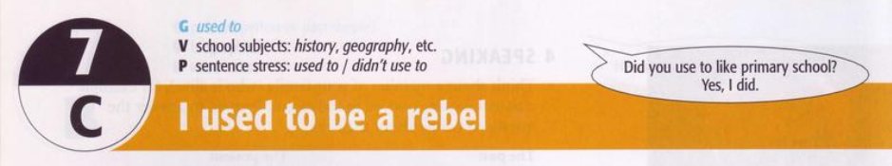

Slide 2
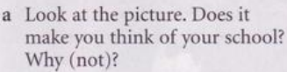
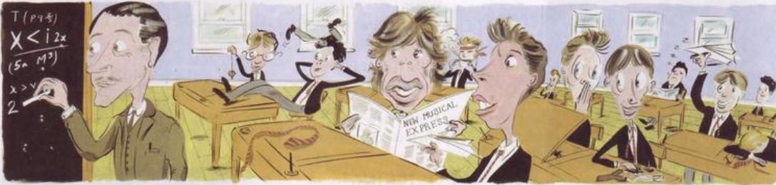
Reading

Slide 3
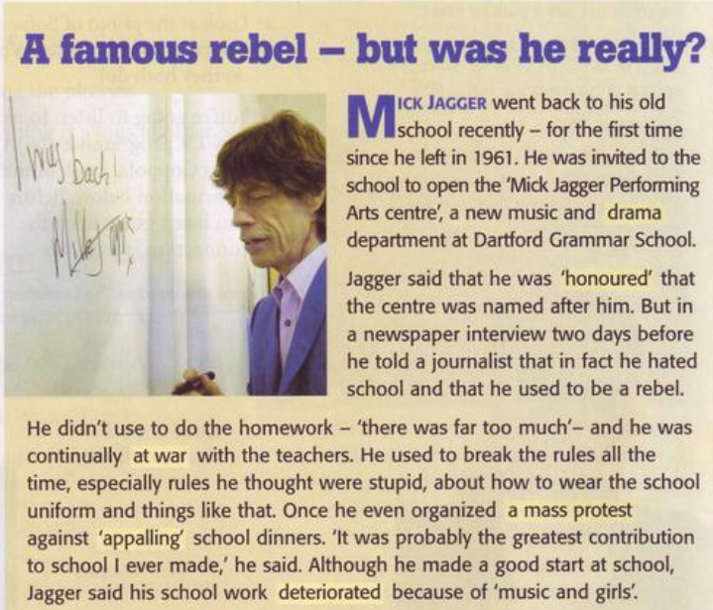
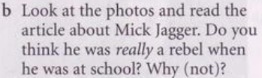
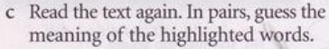
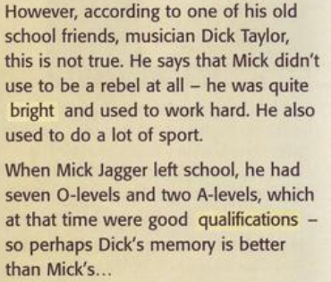

Slide 4
Grammar: used to
I. Cách sử dụng của used to.
Used to được dùng để miêu tả những thói quen hoặc trạng thái đã xảy ra và kết thúc trong quá khứ. Jack used to live in Brighton, but now he lives in Liverpool. People used to believe in magic. II. Cấu trúc câu với used to. 1. POSSITIVE: S + used to V I used to listen to the radio. They used to go swimming together. 2. NEGATIVE: S + did not/ didn't use to V I didn't use to listen to the radio. They did not use to go swimming together 3. APPIRMATIVE: Did + S + use to V? Did you use to listen to the radio? Did they use to go swimming together?

Slide 5
Use “ used” to and a suitable verb to complete the sentences below
1. Liz .... …….a motorbike, but last year she sold it and bought a car.
2. We came to live in London a few years ago. We .... ……..in Leeds.
3. I rarely eat ice-cream now, but I ........... it when I was a child.
4. Jim .............. my best friend, but we aren't good friend any longer.
5. It only takes me about 40 minutes to get to work now that the new road is open. It ................ more than an hour.
6. There .... a hotel near the airport, but it closed a long time ago.
7. When you lived in New York, ................ to the theatre very often?

Slide 6
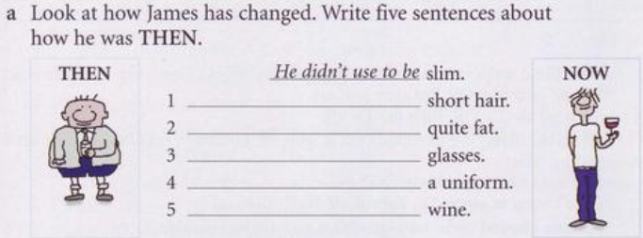
Exercises
He used to have
He used to be
He din’t use to wear
He used to wear
He đin’t use to drink

Slide 7
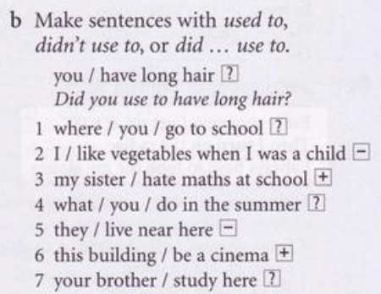
Exercises
1. Where did you use to go to school?
2. I didn’t use to like vegetables when I was a child
3. My sister used to hate maths at school
4. What did you use to do in the summer?
5. They didn’t use to live near here
6. This building used to be a cinema
7. Did your brother use to study here?

Slide 8
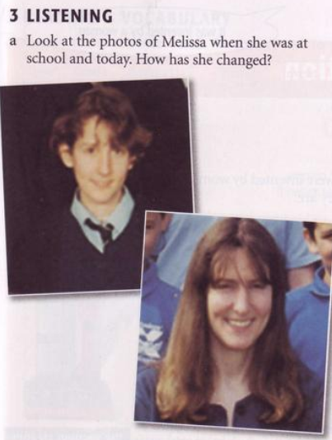
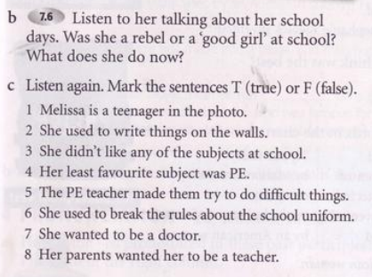

She was a rebel
She is a primary school teacher
T
T
F
T
T
T
F
F

Slide 9
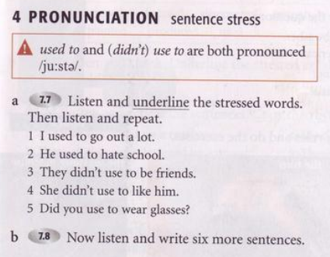

Slide 10
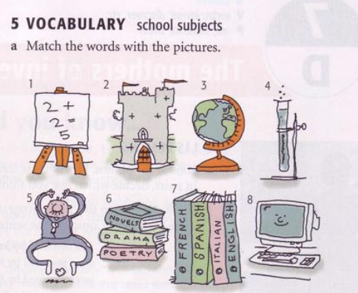
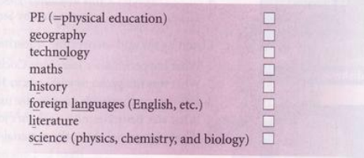
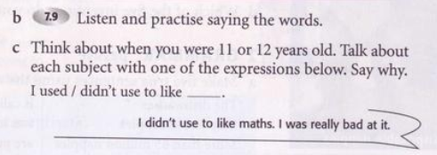
5
3
8
1
2
7
6
4

Slide 11
